Slide 1


Slide 2








THE CASH FLOW QUADRANT
De Robert T. Kiyosaki
AI
ACTIVE INCOME
PI
PASSIVE INCOME
E
B
Employees
Business owners
S
I
Self-employed
Investors
Reinvent your Future

Slide 3

THE CASH FLOW QUADRANT
De Robert T. Kiyosaki
E
EMPLOYEE
TRADE THEIR TIME FOR MONEY
Reinvent your Future

Slide 4

THE CASH FLOW QUADRANT
De Robert T. Kiyosaki
S
SELF-EMPLOYED
PRISONER OF THEIR WORK
Reinvent your Future

Slide 5

THE CASH FLOW QUADRANT
De Robert T. Kiyosaki
BUSINESS OWNER
B
OWNS A SYSTEM
Reinvent your Future

Slide 6

THE CASH FLOW QUADRANT
De Robert T. Kiyosaki
INVESTOR
I
MONEY WORKS FOR THEM
Reinvent your Future

Slide 7


POTENTIAL PASSIVE INCOME
1000 $
À /TO
200.000 $
MONTH / UNLIMITED
Reinvent your Future

Slide 8

BZZWORLD’S 3H SMARTLABS & CONCEPT
Reinvent your Future
Notes:
Refaire design des 3 laboratoires et le concept 3H

Slide 9


BZZWORLD’S 3H PEOPLE
Reinvent your Future
Notes:
Reffaire le design de tous les produits

Slide 10



ANGEL MOON
YOUR INTIMATE COMPAGNON
THE REVOLUTIONARY SANITARY PAD

Slide 11


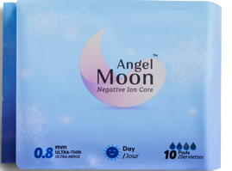
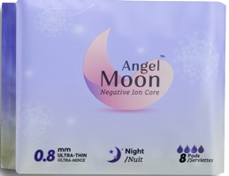
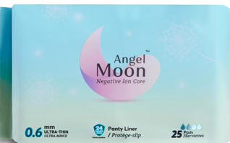
SANITARY NORMS AND STANDARDS
FOR A SANITARY PAD
THERAPEUTIC EFFECT
DEODORISING EFFECT
ANTI-BACTERIAL EFFECT
AIR-PERMEABLE
SUPER ABSORBENT
CONFORTABLE
Reinvent your Future

Slide 12


BENEFITS OF THE NEGATIVE
ION BAND
BOOSTS THE IMMUNE SYSTEM
ELIMINATES BACTERIA
REDUCES STRESS & ERADICATES FATIGUE
ENSURES HORMONAL BALANCE
ERADICATES ODOUR
AMELIORATES METABOLISM
NANO SILVER
NEGATIVE IONS
BIOMAGNETISM
FAR INFRARED
Reinvent your Future

Slide 13
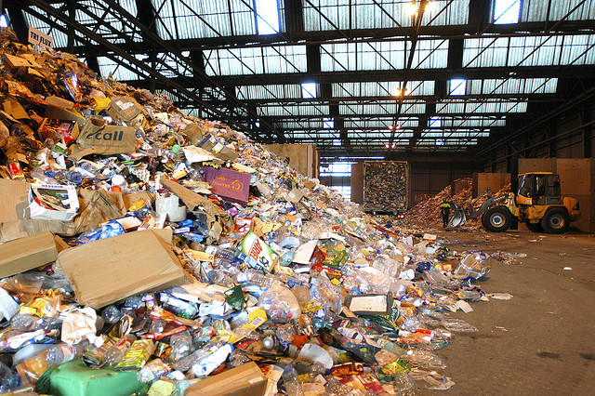
RECYCLED PAPER COLLECTION
Reinvent your Future

Slide 14
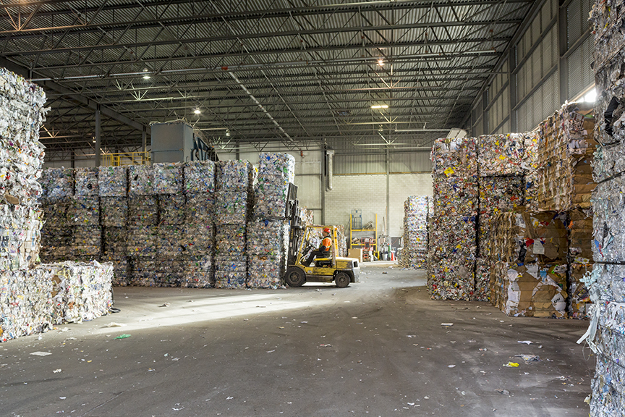
RECYCLED PAPER STORAGE
Reinvent your Future
Notes:
Ajouter les elements toxiques

Slide 15
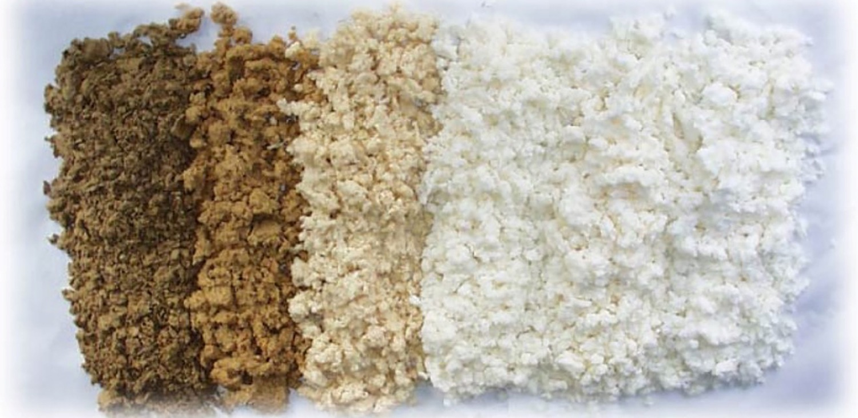
BLEACHING STEPS
Reinvent your Future
Notes:
Ajouter les elements toxiques

Slide 16


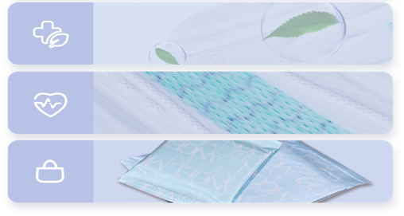
7 CHARACTERISTICS OF
ANGEL MOON
SOFT
THIN
SMARTCORE TECHNOLOGY
SUPER ABSORBENT
BREATHABLE
HYGIENIC
HEALTHY
STYLISH
Reinvent your Future
Notes:
Therapeutique

Slide 17




CERTIFICATIONS
Reinvent your Future

Slide 18





SEXUAL HEALTH AND WELL-BEING

Slide 19

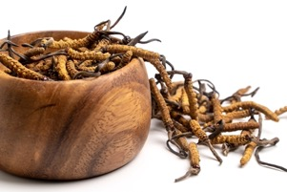
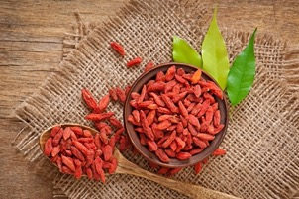

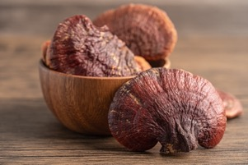
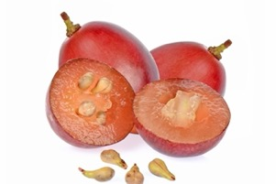
ORGANIC RAW MATERIALS
Increases energy
Increases testosterone
Boosts immunity
Improves blood circulation
Reinvent your Future

Slide 20

ALPHAVMAX: HEALTH
BENEFIT
AN ORGANIC FOOD COMPLEMENT
HORMONAL BALANCE AND REGULATES BLOOD SUGAR LEVEL
BOOSTS EFFECTIVE TESTOSTERONE SECRETION
PROVIDES SEXUAL AND CARDIOVASCULAR STRENGTH
ANTI-OXYDANT AND ANTI-AGING
Reinvent your Future

Slide 21
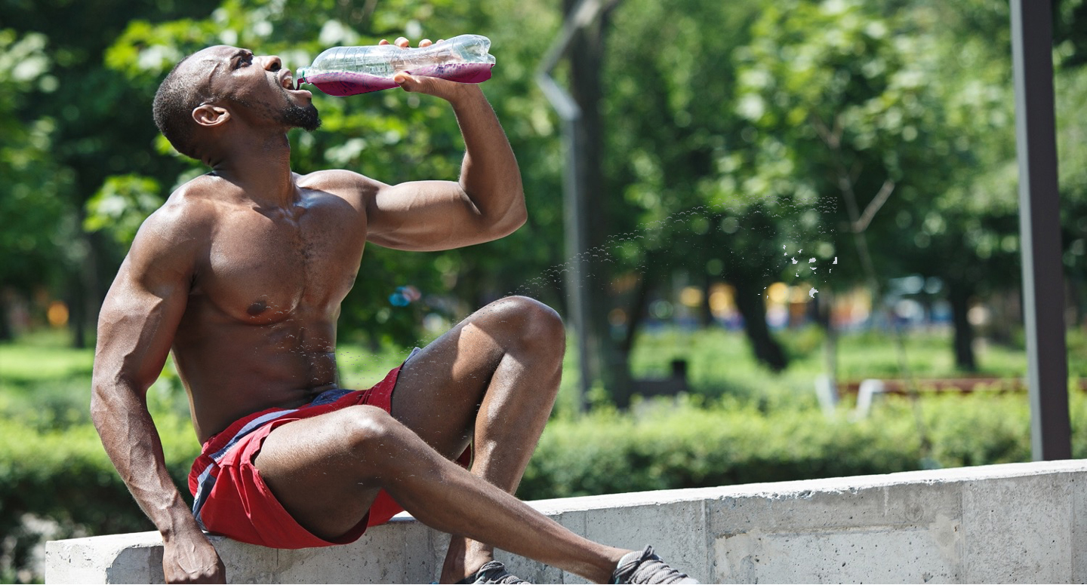

ALPHAVMAX: HOW TO USE
Mode d’usage
1st BOX : 1 SACHET/DAY
2nd BOX : 1 SACHET/ 2DAYS
3rd BOX : 1 SACHET/3DAYS
Reinvent your Future
Notes:
PROGRAMME 48 JOURS

Slide 22


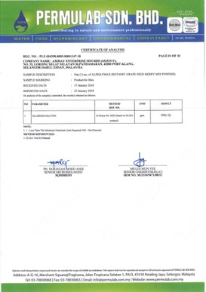
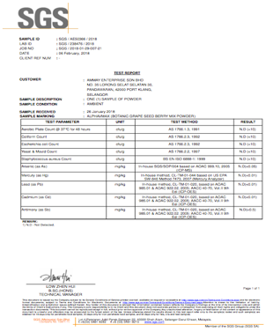
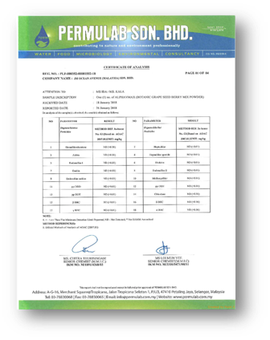
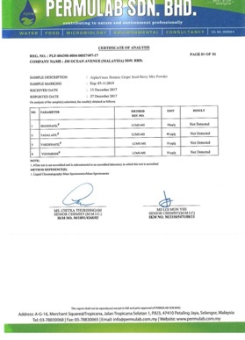

CERTIFICATIONS
SAFE V POWER
TEST FOR MEDICAL PRESCRIPTION
GLUTEN FREE
HEAVY METALS AND GERM FREE
HERBICIDES FREE
Reinvent your Future

Slide 23
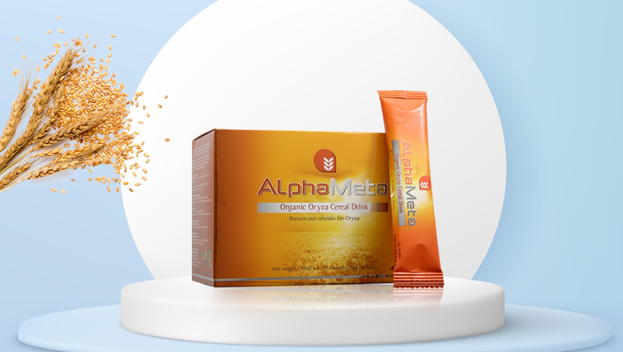

AlphaMeta: CELLULAR NUTRITION
SPARK OF LIFE

Slide 24

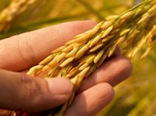
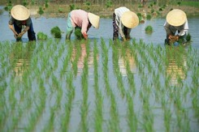
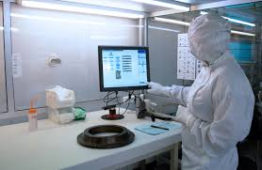
AlphaMeta: CELLULAR NUTRITION
ORGANIC BROWN RICE
FREE FROM TOXIC PRODUCTS AND CHEMICALS
NANOTECHNOLOGY
Reinvent your Future

Slide 25

ADVANTAGES OF ALPHAMETA
FAVOURS ENZYMES & ENERGY PRODUCTION
HELPS IN CELLULAR REGERATION AND IMPROVES IMMUNITY
IMPROVES CELLULAR (DETOXIFICATION, REPARATION AND PROTECTION)
Reinvent your Future

Slide 26

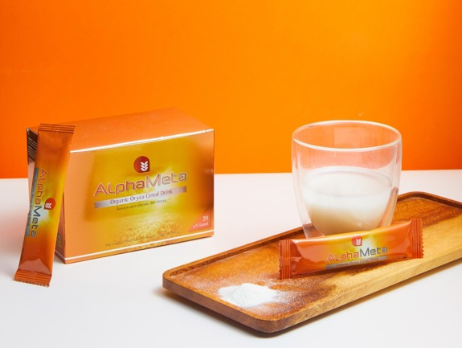
RECOMMENDED CONSUMPTION
1 SACHET INTO 300ML - 1L OF WATER
3 TIMES A DAY BEFORE MEALS, FOR AT LEAST 3 MONTHS
1-2 TIMES A DAY FOR MAINTENANCEE
Reinvent your Future

Slide 27

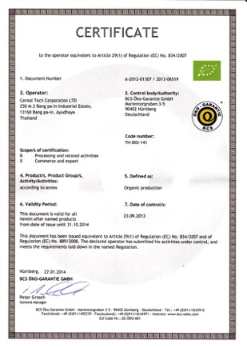
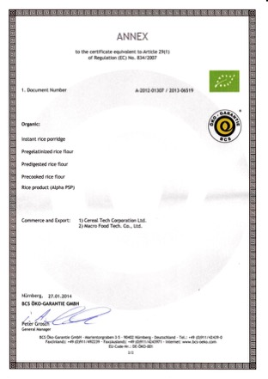
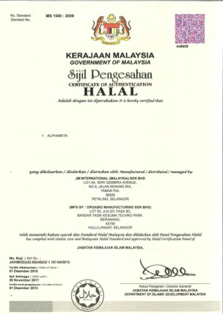
CERTIFICATIONS
EUROPEAN UNION CERTIFICATES
HALAL CERTIFICATE
Reinvent your Future

Slide 28
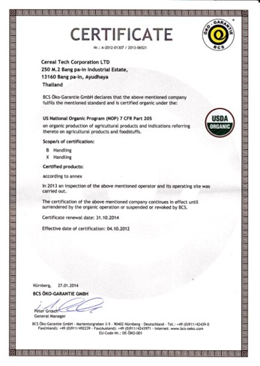
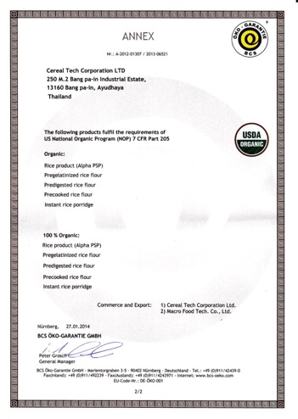
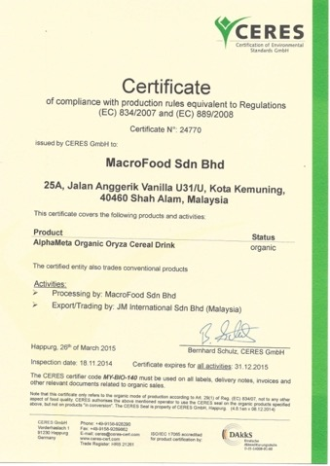
CERTIFICATIONS
US CERTIFICATE
USDA & EU ORGANIC CERTIFICATE
Reinvent your Future

Slide 29
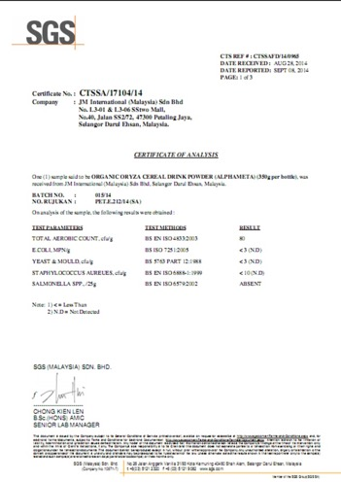
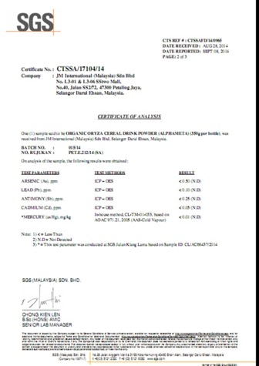
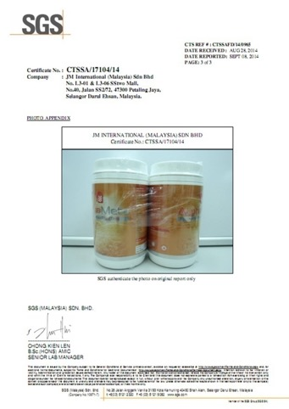
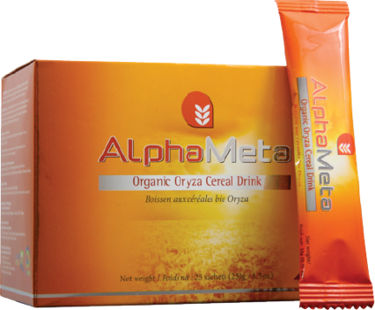
CERTIFICATIONS
SGS CERTIFICATIONS
Reinvent your Future
Notes:
AJOUTER LA NOUVELLE CERTIFICATION D’ALPHA META , ET METTRE TOUTES LES CERTIFICATIONS SUR UNE DIAPOSITIVE COMME EZENO

Slide 30



Slide 31



THERAPEUTIC SOAP
CLEANSING
NOURISHING
REJUVENATING
Reinvent your Future

Slide 32



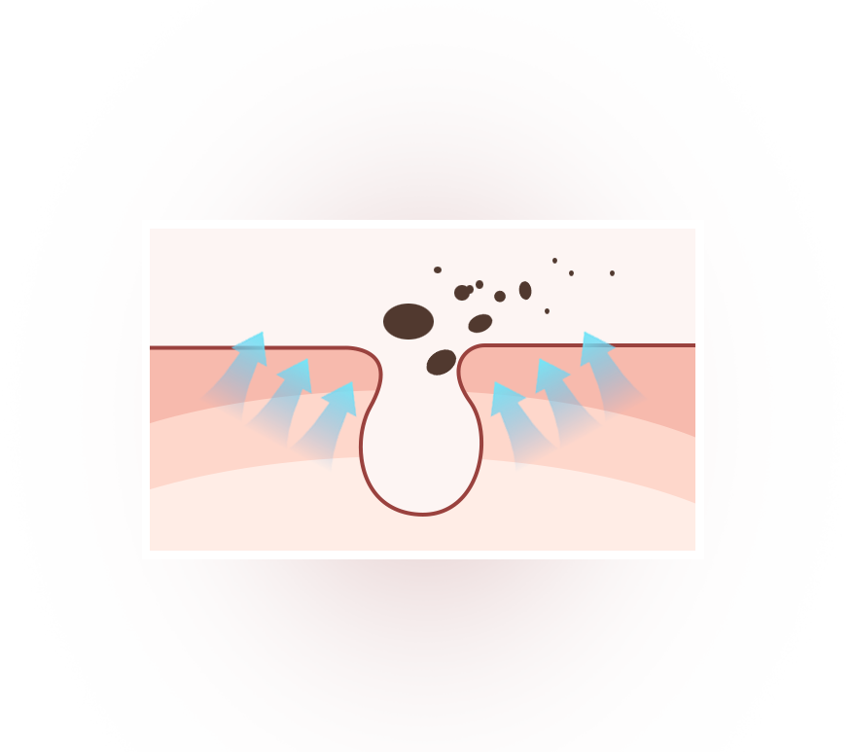
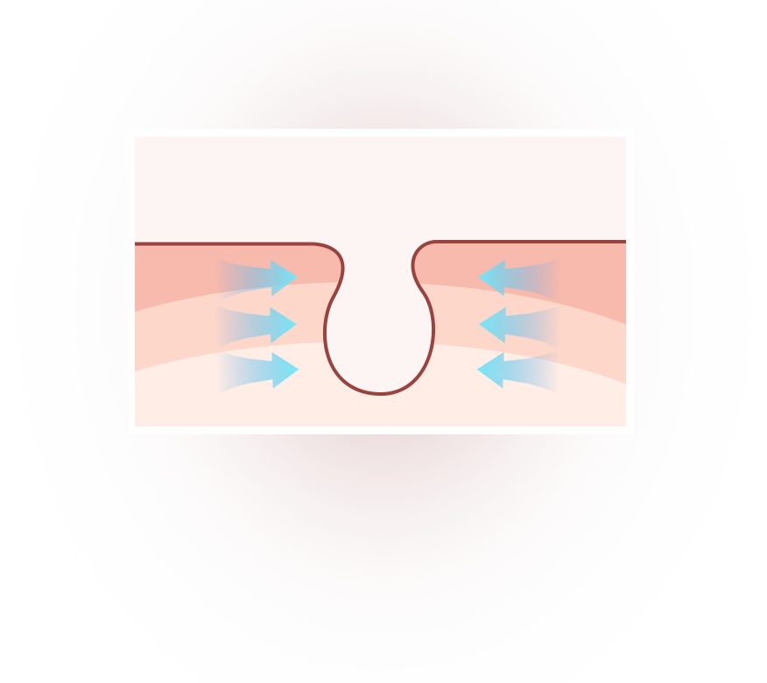
DEEP PORE CLEANING
REMOVING EXCESS OIL AND DIRT
NATURAL PLANT BASED SOAP
DEEP CLEANING
SMALLER MOLECULAR FOAM FOR EASIER PENETRATION INTO PORES
REMOVES DIRT RESIDUES
TIGHTENS PORES FOR CLEAR, REFINED SKIN
Reinvent your Future

Slide 33

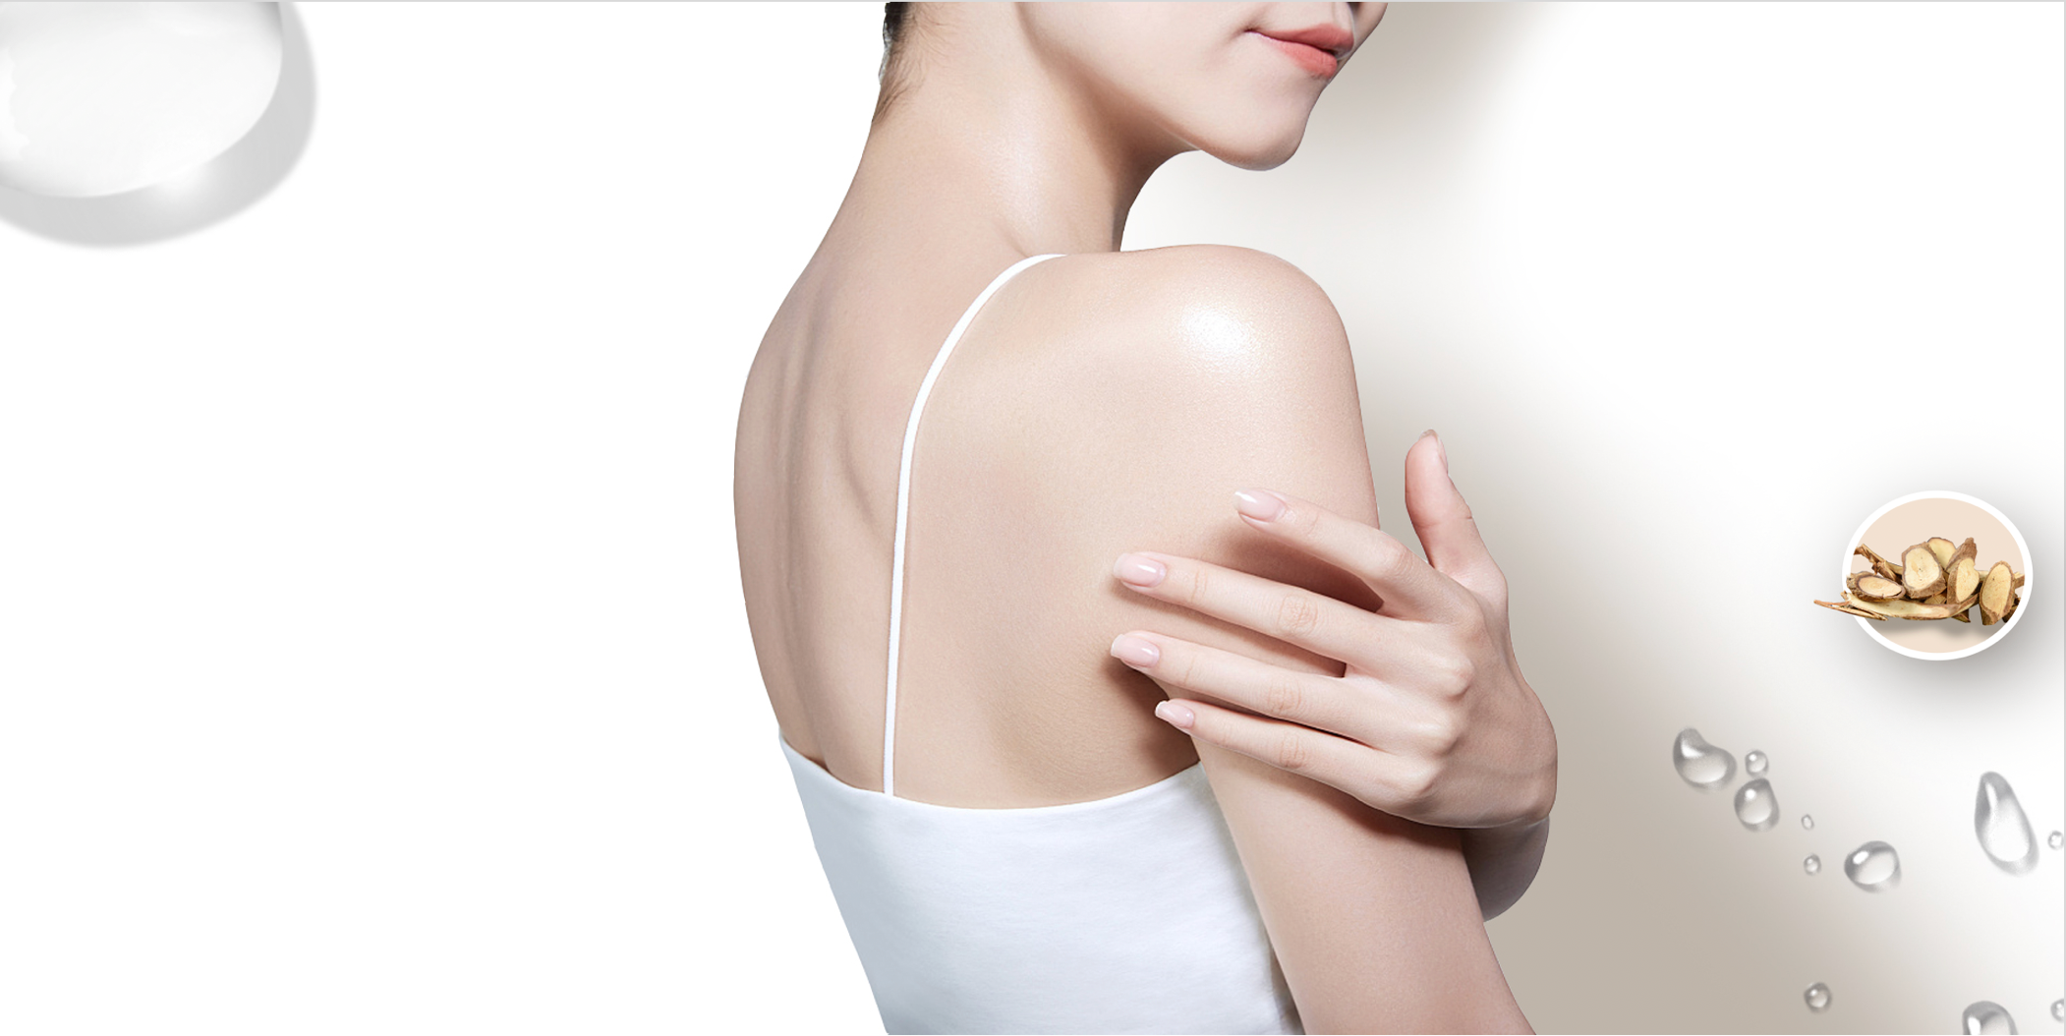
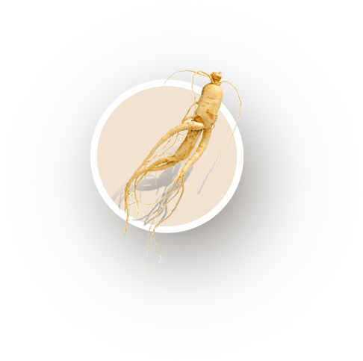



MINOSEED COMPONENTS
GENTLE, MOISTURISING AND
SKIN-FRIENDLY
GINSENG
COCONUT OIL
SOPHORA FLAVESCENS
TEA TREE OIL
Reinvent your Future

Slide 34
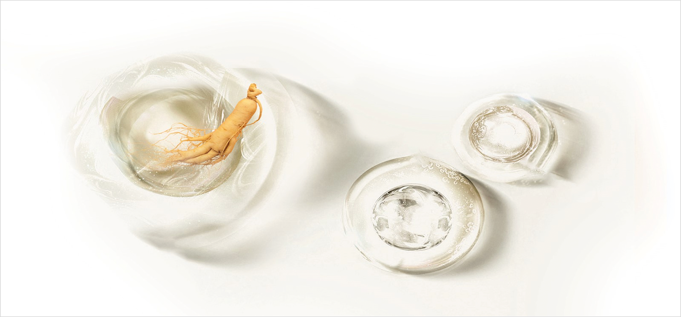



GINSENG ROOTS
INCREASES OVERALL CELL RESILIENCE
ANTI-OXIDATION
ANTI-BACTERIAL
ANTI-INFLAMATION
PROMOTES CELL REJUVENATION
Reinvent your Future

Slide 35
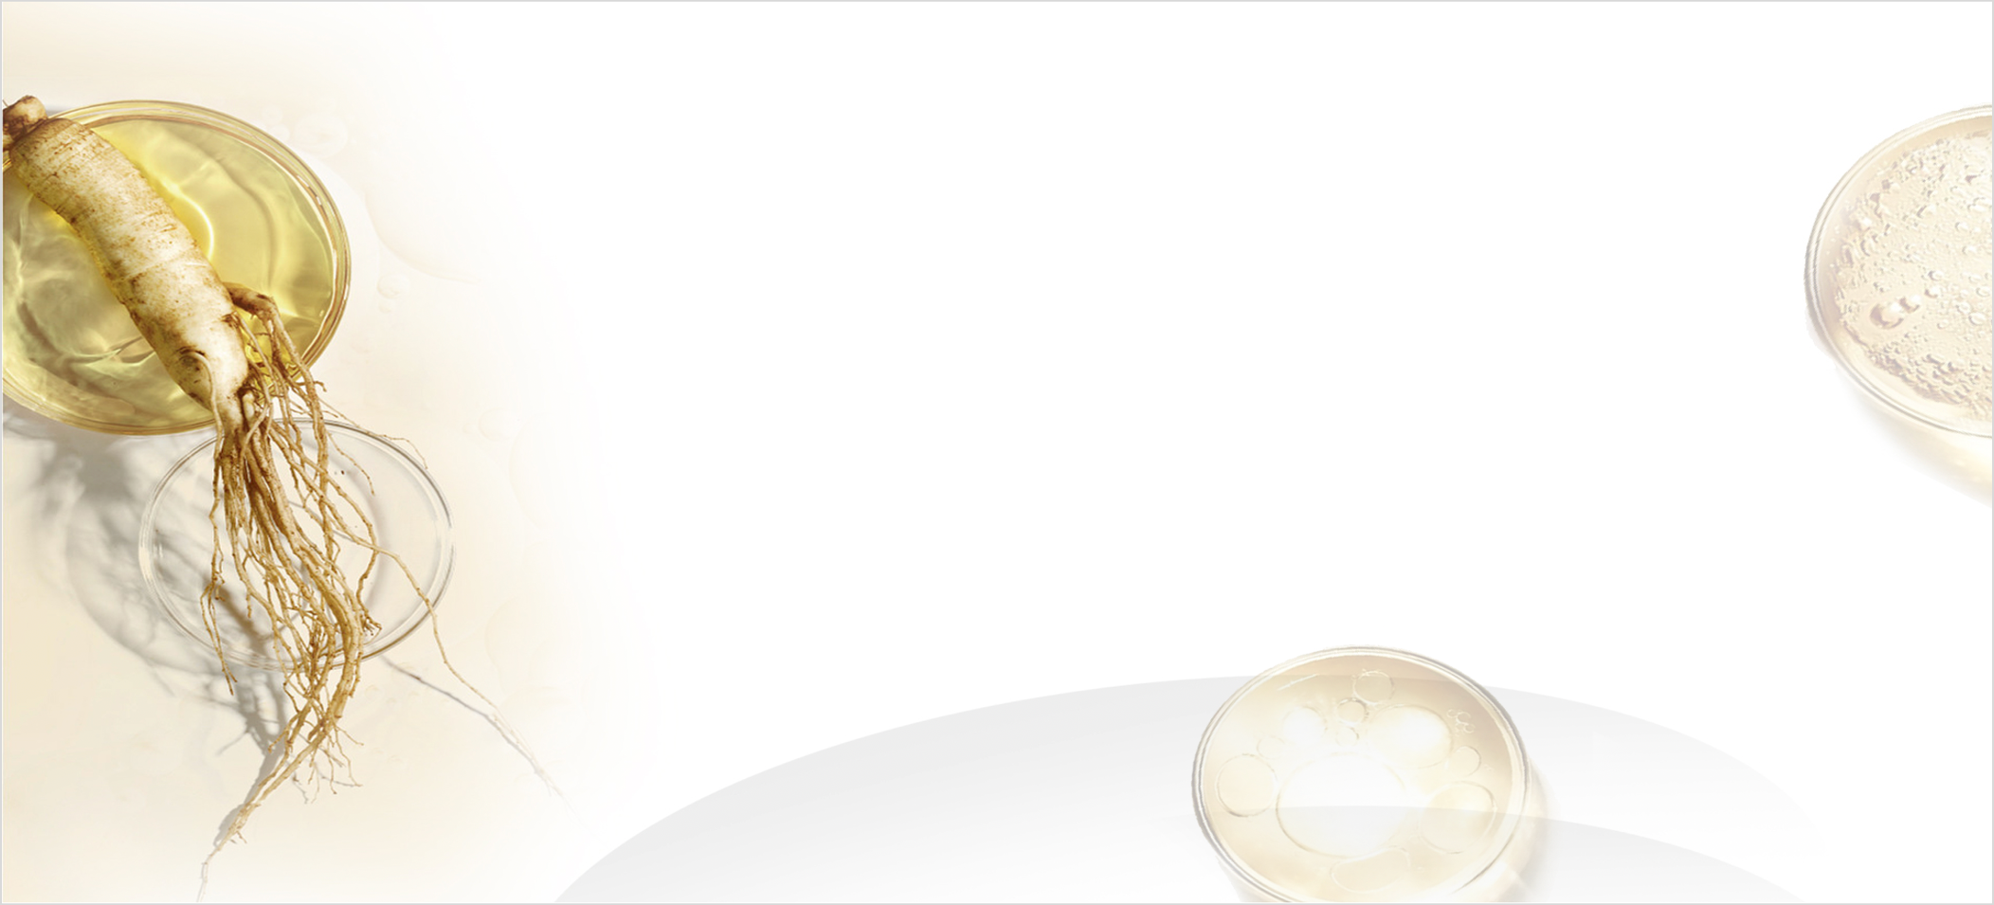
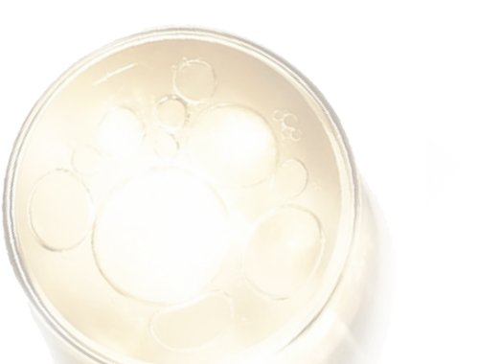
EXTRACT OF SOPHORA FLAVESCENS
ANTIBACTERIAL AND ANTI-ACARINA EFFECTIVENESS ≥ 99,9%.
EXCELLENT FOR ELIMINATING DUST MITES
ALKALOID FOR ANTI-BACTERIAL EFFECT
Reinvent your Future

Slide 36
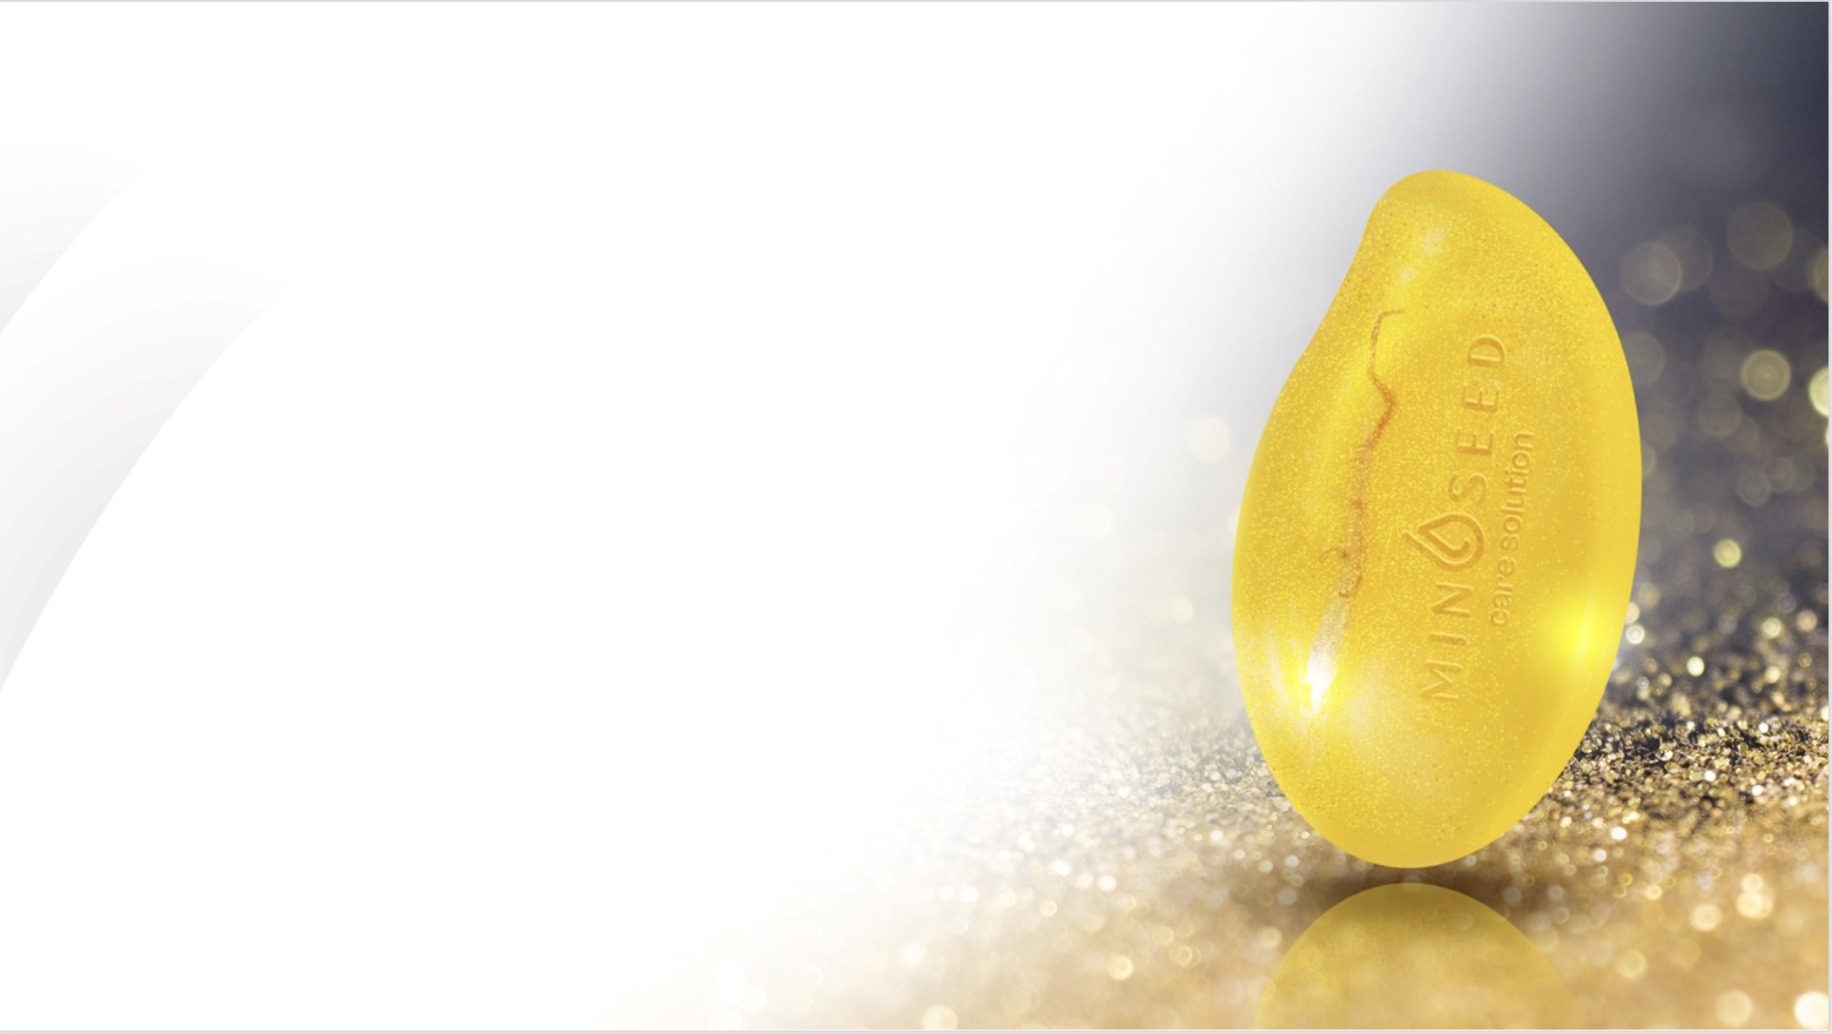

GOLD LEAF PARTICLES
13
29
14
%
%
%
INCREASES FIRMNESS OF FACIAL SKIN
REDUCES SKIN SCALES ON THE FOREARM
IMPROVES THE SOFTNESS OF THE SKIN ON THE FOREARM
Reinvent your Future

Slide 37
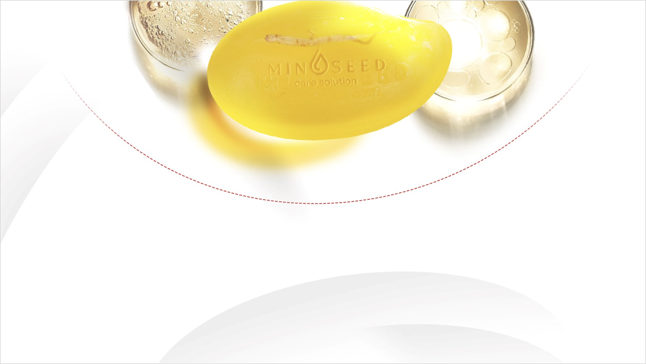




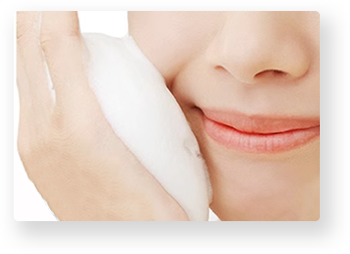
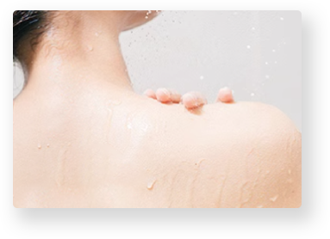
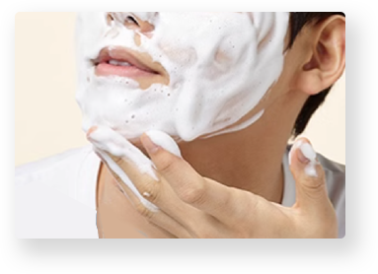
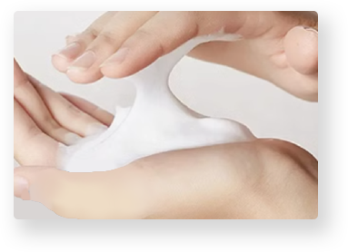
4 IN 1
MULTIPLE USE
FACIAL CLEANSER
HAND WASH
BODY WASH
HAIR-REMOVAL CREAM
Reinvent your Future

Slide 38
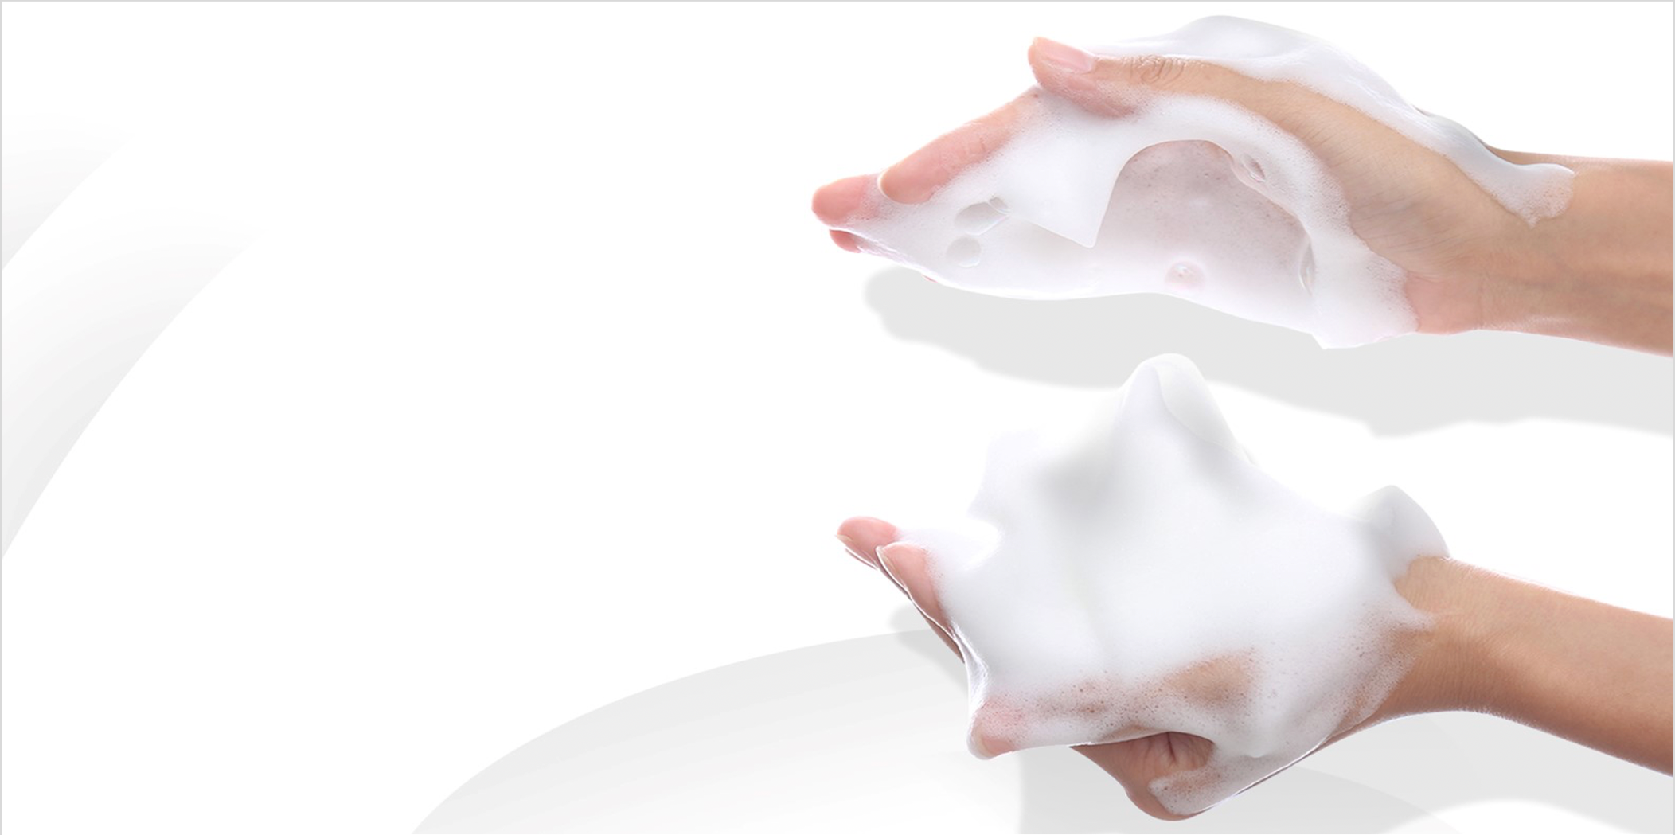



CREAMY, DENSE FOAM
RUB GENTLY TO CREATE
A RICH LATHER
CLEANSES
LOSE
NON IRRITATING
Reinvent your Future

Slide 39




SPA EXPERIENCE
FOAMS UP QUICKLY
INSTANT CLEANING
RICH SENSOR
Reinvent your Future

Slide 40
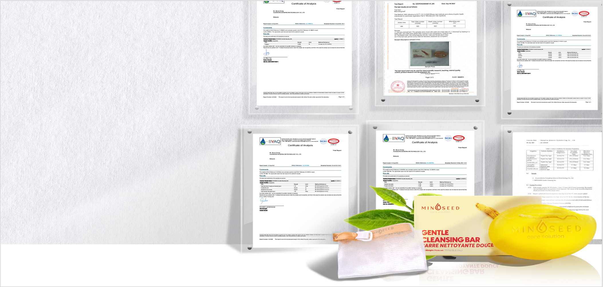

CERTIFICATIONS
WITHOUT HEAVY METALS
MICROBIOM
BACTERIA-FREE
PARABEN-FREE
WITHOUT TRICLOSAN
ALLERGEN-FREE
99.91% DUST MITE ELIMINATION
ELIMINATES 99.91% OF BACTERIA
Reinvent your Future

Slide 41


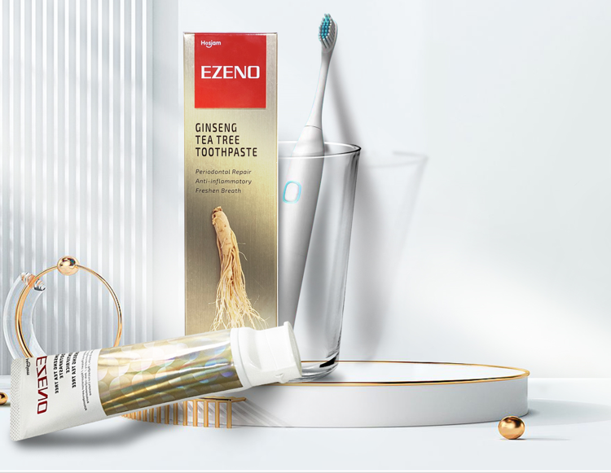
EZENO: THERAPEUTIC TOOTHPASTE
ORAL HEALTH WITH GINSENG

Slide 42
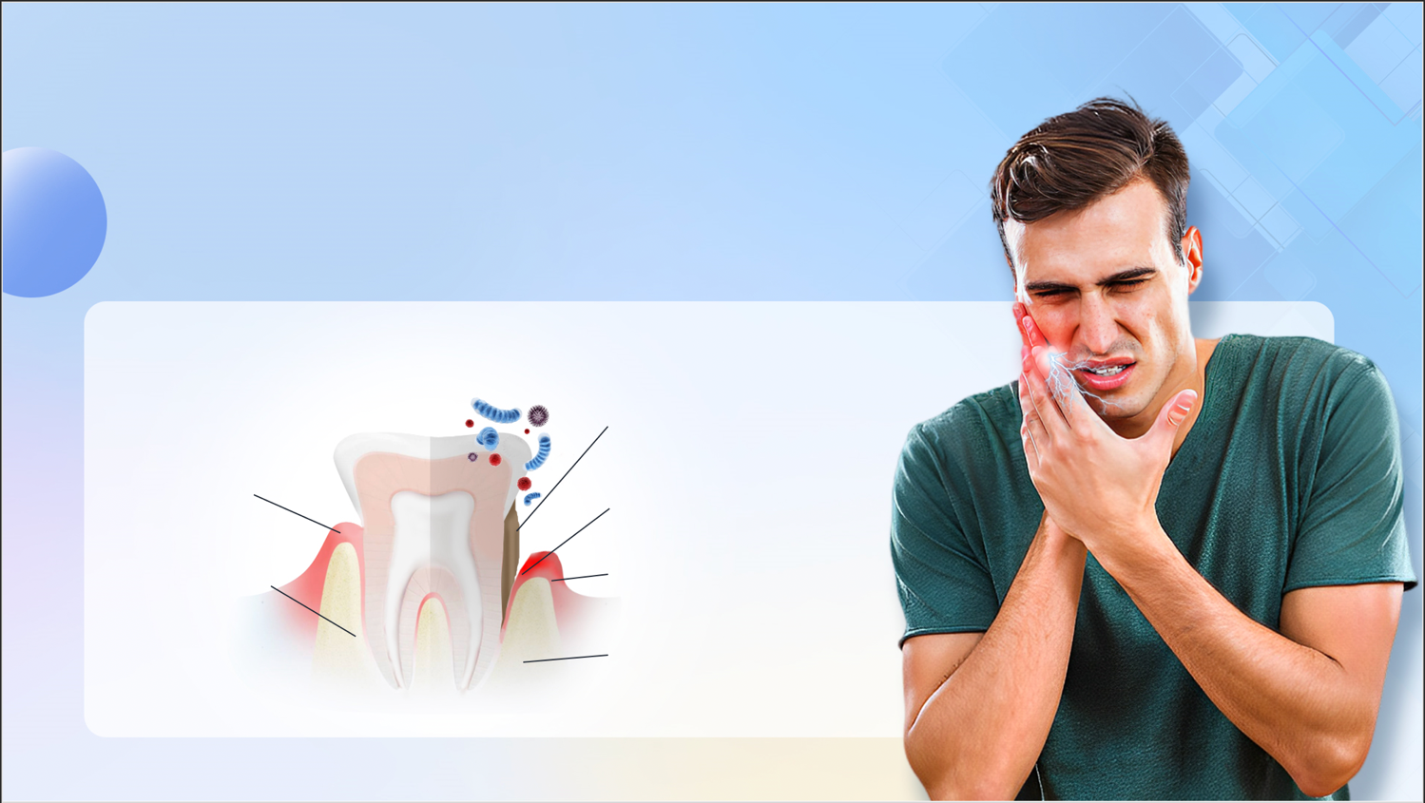




PAINFUL EXPERIENCES
BACTERIAL GINGIVITIS!
BAD BREATH
SWOLLEN GUMS AND BLEEDING
NORMAL TOOTH
PARIODONTITIS
Plaque
TOOTH ACHE
Periodontal pocket
GUM
JAW BONE
Inflammation
Reduction in bone level
Reinvent your Future

Slide 43


GINSENG - THE KING OF CHINESE MEDICINE
PANAX GINSENG EXTRACT
CONTAINS 30 TYPES OF SAPONIN AND GINSENOSIDES
REPAIRS GUMS WITHIN 1 TO 2 WEEKS
ANTI-INFLAMMATORY AND ANTIMICROBIAL PROPERTIES
24 HOURS OF LONG-LASTING PROTECTION
IMPROVES THE PERIODONTIUM WITHIN 3 TO 4 WEEKS
Reinvent your Future

Slide 44
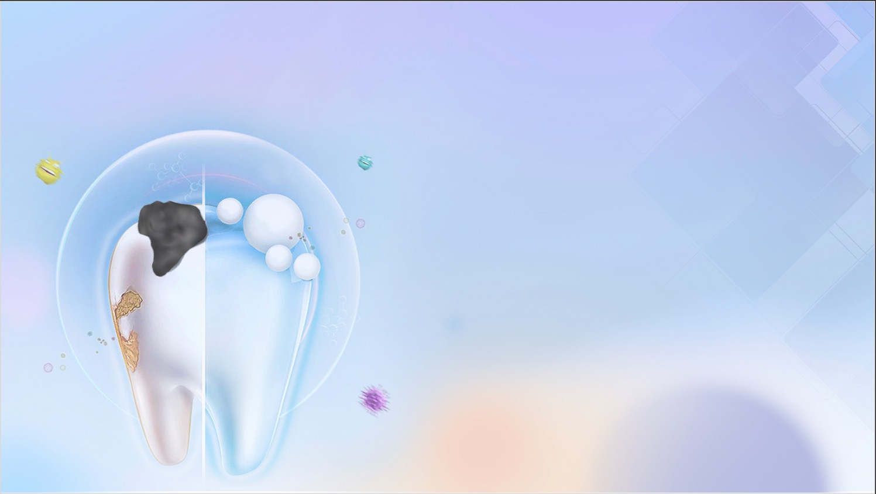
GINSENG - THE KING OF CHINESE MEDICINE
LONG-TERM PROTECTION AGAINST 99.9% OF BACTERIA.
DENTAL CARIES
GINSENG EXTRACT PROVIDES EFFECTIVE PROTECTION AGAINST PLAQUE AND TOOTH DECAY.
DENTAL PLAQUE
Reinvent your Future

Slide 45
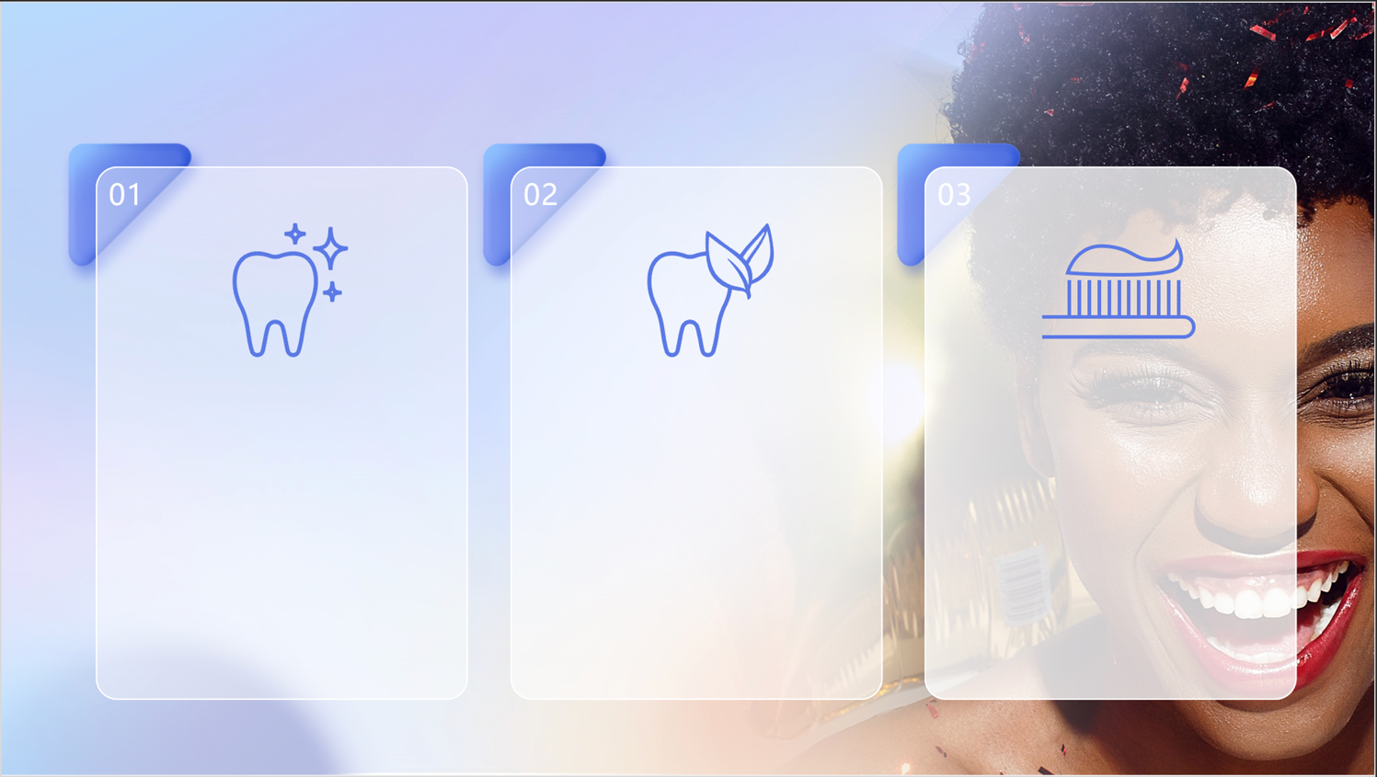
EZENO – MORE THAN A THOOTHPASTE
FRESH BREATH
SUPERIOR DOUGH TEXTURE
DEEP CLEANSING
SILICIA ABSORBS STUBBORN
STAINS
PREVENTS STAINS FROM STICKING
TEA TREE OIL ABSORBS
ODOUR PARTICLES
FINE AND SMOOTH
GIVES YOU FRESHER, LONGER-LASTING BREATH
HIGH-DENSITY FOAM
Reinvent your Future

Slide 46


EZENO – MORE THAN JUST TOOTHPASTE
USAGE
BRUSH THOROUGHLY AT LEAST TWICE A DAY
Reinvent your Future

Slide 47





CERTIFICATIONS
2
PATENTS GRANTED
3
4
CLINICAL REPORTS APPROVED
INSPECTION PASSED
FLUOR-FREE
TRICOSAN FREE
ALCOOL FREE
STEROID-FREE
BACTERIA FREE
HEAVY METALS FREE
Reinvent your Future
Notes:
加个总结，获得多少认可

Slide 48




Slide 49




WONDERGUARD
INTELLIGENT HYGIENE PROTECTION SOLUTION
AIRBORNE INCU TECHNOLOGY
THE WORLD'S FIRST AIRBORNE INCU SOLUTION
HIGHLY EFFECTIVE AND SAFE FOR DISINFECTING AIR AND SURFACES.
99.99% EFFECTIVE IN DESTROYING VIRUSES (CORONAVIRUS, INFLUENZA H1N1, H2N3, SARS, SEAS)
Reinvent your Future

Slide 50

BENEFITS
PURIFIES THE ENVIRONMENT
DIFFUSES NEGATIVE IONS
POWERFUL ANTISEPTIC EFFECTS
ELIMINATES PARASITES AND FUNGI
ELIMINATES ALLERGENS AND TOXINS FROM THE AIR
Reinvent your Future

Slide 51
BENEFITS
DISINFECTS UP TO 99.9
HUMIDIFIES THE ENVIRONMENT
PROTECTS AGAINST ALLERGIES
NEUTRALISES MOULD
ELIMINATES ODOURS IN THE AIR
Reinvent your Future

Slide 52




CERTIFICATIONS
IONIC CONCENTRATE OF NANO-COPPER
NATURAL MINERAL SOURCE FROM CANADA
NSF & EPA CERTIFIED NON-TOXIC AND
SAFE
A PRODUCT OF NANOTECHNOLOGY
SIDE EFFECTS
Reinvent your Future

Slide 53


BRING BAMA HOME
AlphaSpin
Straw
AlphaSpin

Slide 54




BAMA, VILLAGE OF CENTENARIANS

Slide 55

ELECTROMAGNETIC POLLUTION
POLLUTED ENVIRONMENT
HARMONISED ENVIRONMENT
Reinvent your Future

Slide 56



ELECTROMAGNETIC POLLUTION
Reinvent your Future

Slide 57

ELECTROMAGNETIC POLLUTION
GROWTH, BEHAVIOUR & NEUROLOGICAL DISORDERS
Reinvent your Future

Slide 58




ELECTROMAGNETIC POLLUTION
SILENT KILLERS
Reinvent your Future

Slide 59


ALPHASPIN
Reinvent your Future

Slide 60


WHAT IS AN ALPHASPIN?
- WELLBEING TOOL EMITTING NATURAL FREQUENCIES NAMED SCALARS
TOOL DESIGNED TO SYNCHRONIZE THE HUMAN MIND AND ERADICATE RADIATIONS
HARMONISER OF UNIVERSAL QUANTUM FIELDS
HARMONISER OF NATURAL FREQUENCIES
HARMONISER OF ELECTROMAGNETIC FIELDS
STRUCTURES LIQUIDS
Reinvent your Future

Slide 61
ALPHASPIN BENEFITS
- FAVOURABLE FOR A GOOD SLEEP QUALITY
BALANCES THE YING AND YANG ENERGY
IMPROVES ENDURANCE AND ENERGY
IMPROVES THE TASTE OF FOOD AND DRINKS
REDUCES COMMON PAIN
IMPROVES BLOOD CIRCULATION
Reinvent your Future

Slide 62
ALPHASPIN BENEFITS
- HELPS SMOKERS TO EXPEL NICOTINE DERIVED FROM CIGARETTES
- INCREASES VIGOR IN MEN AND WOMEN
- IMPROVES GROWTH IN PLANTS
- HELPS TO CONSERVE FOOD STUFFS IN THE FRIDGE
- IMPROVES THE ABSORBTION OF BEAUTY PRODUCTS
- IMPROVES THE QUALITY OF POTABLE WATER
Reinvent your Future

Slide 63



BUILDING THE QUANTUM FIELD
HARMONIZATION
DUALITY
Reinvent your Future

Slide 64


BUILDING THE QUANTUM FIELD
STABILISATION
COMMUNICATION
Reinvent your Future

Slide 65


BUILDING THE QUANTUM FIELD
QUANTUM FIELD
=
BAMA AT HOME
Reinvent your Future

Slide 66




ENVIRONMENTAL APPLICATIONS
HARMONIZE YOUR ENVIRONMENT WITH 5 ALPHASPINS
STRUCTURED WATER TO PURIFY AIR
Reinvent your Future

Slide 67



ALPHASPIN USAGE
STRUCTURES DRINKS AND WATER
Reinvent your Future

Slide 68


ALPHASPIN USAGE
REFLEXOLOGY
FUEL CONSUMPTION
Reinvent your Future

Slide 69


ALPHASPIN USAGE
PROTECTS FROM EMF RADIATION
KEEPS VEGETABLES AND FRUITS FRESH
Reinvent your Future

Slide 70





ALPHASPIN AND LIVING WATER
ALPHASPIN TRANSFORMS NORMAL WATER INTO INVIGORATING OR STRUCTURED WATER
TAP WATER OR BOTTLED WATER NOT TREATED WITH ALPHASPIN
BECOMES ENERGISING WATER
AND STRUCTURED
WATER TREATED WITH ALPHASPIN
Reinvent your Future

Slide 71

ALPHASPIN STRAW, MORE THAN A STRAW
STABLE SCALAR ENERGY
REUSABLE & ECOLOGICAL
SUITABLE FOR ALL DRINKS
EASY TO CLEAN

Slide 72


BENEFITS OF STRUCTURED WATER
IMPROVES BLOOD CIRCULATION
RELIEVES MIGRAINE PAIN
IMPROVES CONCENTRATION
RELAXES AND ALLEVIATES THE BIOLOGICAL
EFFECTS OF STRESS
ENERGIZES YOUR BODY
INCREASES THE OXYGEN CONTENT OF THE WATER
Reinvent your Future

Slide 73





STRAW
BLOOD ANALYSIS
BEFORE AFTER
UNSTRUCTURED WATER
LOW BLOOD OXYGEN LEVELS
STRUCTURED WATER THROUGH ALPHASPIN VERY HIGH LEVEL OF OXYGEN IN THE BLOOD
Reinvent your Future

Slide 74

CERTIFICATIONS
“ Mobile phone radiation can be reduced by both the Alphaspin Natural and the Quantum Energy Field to become Alpha waves as these resonate with the frequency embedded in the Alphaspin Natural. ”
——Dr Carlos
MOBILE PHONE RADIATION TEST
Reinvent your Future

Slide 75



CERTIFICATIONS
FOOD
ACCEPTABILITY
HEAVY METALS FREE
Reinvent your Future

Slide 76





CERTIFICATIONS
RADIATION-FREE
Reinvent your Future

Slide 77



CERTIFICATIONS
HEAVY METALS FREE AND CAN BE USED ON FOODSTUFFS
Reinvent your Future
Notes:
METTRE TOUTES LES CERTIFICATION SUR UNE DIAPOSITIVE COMME EZENO

Slide 78



3H LIFESTYLE

Slide 79

HOW TO DEFINE A RESTFUL
SLEEP?
RESTFUL SLEEP
POOR SLEEP
QUICK SLEEP
INSOMNIA
UNINTERRUPTED SLEEP
PROFUSE SWEAT
MAUVAISE QUALITÉ DE SOMMEIL
Poor quality sleep
RESTORATIVE SLEEP
Reinvent your Future

Slide 80



Sleep disorders & electromagnetic waves cause poor blood circulation
POOR BLOOD CIRCULATION
Insufficient
OXYGEN SUPPLY
NUTRIENT SUPPLY
WASTE EXCRETION
Reinvent your Future

Slide 81





JOINT DISEASES
POOR FLEXIBILITY
PAIN
BONE & SPINAL DISEASE
Reinvent your Future

Slide 82



SLEEP DISORDERS
AFFECTS YOUR HEALTH
STRESS, ANXIETY AND DEPRESSION
CHRONIC AND METABOLIC DISEASES
NEURODEGENERATIVE DISEASES
OBESITY, INSULIN RESISTANCE
HORMONAL DISORDERS
PREMATURE AGEING
LOW STAMINA & SEXUAL PROBLEMS
Reinvent your Future

Slide 83




MULTIPLE-LAYER DESIGN
ICE SILK COOLING LAYER
2. AIR PROTECTION LAYER
3. BIOMAGNETIC LAYER
4. PROTECTIVE LAYER
5. FAR-INFRARED FILLER LAYER
6. NON-SLIP INSULATION LAYER
Reinvent your Future

Slide 84



iSMART S3 FUNCTIONS
PROVIDES> 4000 IONS / CM3
PROMOTES DEEP SLEEP
REGULATES BLOOD PH
INCREASES OXYGEN-BINDING CAPACITY
Reinvent your Future

Slide 85





iSMART S3 PILLOW
ZERO GRAVITY
FITS THE NECK IN ANY POSITION
DOUBLE-SIDED DESIGN
DOES NOT DEFORM
ZERO GRAVITY DESIGN
Reinvent your Future

Slide 86



iSMART S3
Reinvent your Future

Slide 87





CERTIFICATIONS
ANTI BACTERIAL TEST
ANTI DUST MITE TEST
ANTI ODOR TEST
AZO DYE SAFETY TEST
FORMALDEHYDE FREE TEST
RADIATION FREE TEST
FUNCTIONAL TEST (ANION)
INSTANT CONTACT COOLING
FEELING TEST
Reinvent your Future

Slide 88





Slide 89
ENTRY LEVEL
GRADE | BONUS VALUE FIRST PURCHASE
SILVER | 50 BV
PLATINUM | 600 BV
DIAMOND | 900 BV
Reinvent your Future

Slide 90
FOUR DIFFERENT BONUSES
RETAIL PROFIT
PRODUCT SHARING BONUS
GROUP BONUS
UNILEVEL BONUS
Reinvent your Future

Slide 91
1. RETAIL PROFIT
10% - 30%
Reinvent your Future

Slide 92

2. PSB
(PRODUCT SHARING BONUS)
 | GRADE | PSB | DOLLAR
DIRECT SPONSOR
SILVER
20% x DSBV
10$
YOU
PLATINUM
20% x DSBV
120$
DIAMOND
20% x DSBV
180$
Reinvent your Future

Slide 93
PSB BOOSTER
FIRST ENROLLED | BOOSTER EFFECTIVE | PRODUCT SHARING BONUS
PLATINUM
IN FIRST 60 DAYS AFTER
FIRST ENROLLEMENT
30% x DSBV
DIAMOND
IN FIRST 90 DAYS AFTER
FIRST ENROLLEMENT
40% x DSBV
Reinvent your Future

Slide 94


3. GROUP BONUS
YOU
Reinvent your Future

Slide 95
GROUP BONUS
MAX OUT
GRADE | GROUP BONUS | DOLLAR | CARRY OVER
SILVER | 10% | 1 000 $ | 10 000 BV
PLATINUM | 11% | 6 600 $ | 60 000 BV
DIAMOND | 12% | 12 000 $ | 100 000 BV
OCEAN DIAMOND | 20% | 50 000 $ | 250 000 BV
Reinvent your Future

Slide 96
4. UNILEVEL BONUS
LEVEL | MONTHLY MPA 50 – 99 BV | MONTHLY MPA 100 BV AND ABOVE | MONTHLY MPA 100 BV AND ABOVE
 |  |  | 2 LEGS 2 000BV EACH (MONTHLY)
G1 | 10% | 10% | 10%
G2 | 5% | 5% | 5%
G3 | 5% | 5% | 5%
G4 |  | 5% | 5%
G5 |  | 5% | 5%
G6 |  | 5% | 5%
G7 |  |  | 5%
G8 |  |  | 5%
G9 |  |  | 5%
G10 |  |  | 5%

Slide 97
UPGRADE
SILVER
600 BV
PLATINUM
ACCUMULATE
SILVER
&
PLATINUM
900 BV
DIAMOND
PURCHASE IN SINGLE RANK ORDER
Reinvent your Future

Slide 98

PRODUCT PRICES IN AFRICA
PRODUCTS | BV | PURCHASE PRICES (FCFA)
ANGEL MOON | 25 | 37 000
ALPHA VMAX | 25 | 37 000
ALPHA META | 25 | 37 000
EZENO | 25 | 38 000
WONDERGUARD | 25 | 37 000
MINOSEED | 25 | 38 000
STRAW | 100 | 128 000
iSMART S3 PILLOW | 100 | 145 000
ALPHA SPIN | 300 | 410 000
iSMART S3 | 600 | 915 000
Reinvent your Future

Slide 99
PRODUCT PRICES IN DRC
PRODUCTS | BV | PURCHASE PRICE (USD)
ANGEL MOON | 25 | 65
ALPHA VMAX | 25 | 65
ALPHA META | 25 | 65
EZENO | 25 | 65
WONDERGUARD | 25 | 65
MINOSEED | 25 | 65
STRAW | 100 | 220
iSMART S3 PILLOW | 100 | 240
ALPHA SPIN | 300 | 700
iSMART S3 | 600 | 1 460
Reinvent your Future

Slide 100
PRODUCT PRICES
(COUNTRY WITHOUT BZZWORLD COMPANY)
PRODUCTS | BV | PURCHASE PRICE (FCFA)
ANGEL MOON | 25 | 45 000
ALPHA VMAX | 25 | 45 000
ALPHA META | 25 | 45 000
EZENO | 25 | 45 000
WONDERGUARD | 25 | 45 000
MINOSEED | 25 | 45 000
STRAW | 100 | 145 000
iSMART S3 PILLOW | 100 | 175 000
ALPHA SPIN | 300 | 445 000
iSMART S3 | 600 | 1 100 000
Reinvent your Future

Slide 101
PRODUCT PRICES IN EUROPE
PRODUCTS | BV | PURCHASE PRICE (EURO)
ANGEL MOON | 25 | 73
ALPHA META | 25 | 61
ALPHA VMAX | 25 | 77
ALPHA SPIN STRAW | 100 | 233
ALPHA SPIN | 300 | 691
Reinvent your Future

Slide 102
PRODUCT PRICES IN THE USA
PRODUCTS | BV | PURCHASE PRICE (USD)
ANGEL MOON | 25 | 56
ALPHA META | 25 | 57
ALPHA BLOSSOM | 25 | 57
ALPHA VMAX | 25 | 57
ALPHA SPIN | 300 | 639
iSMART S3 | 600 | 1 600
Reinvent your Future

Slide 103




Slide 104




DR. BRUCE FANG
Founder and Chairman of BZZWORLD GROUP
Notes:
EDIFICATION DU DR BRUCE ET LES SMARTLABS

Slide 105


GLOBAL BUSINESS
U.S.A
ITALIE
COREE
JAPON
SÉNÉGAL
NIGERIA
BENIN
TOGO
CAMBODGE
CÔTE
D’IVOIRE
PHILIPPINES
CAMEROUN
OUGANDA
MALAISIE
RDC
SINGAPOUR
INDONESIE
PAPUA
NOUVELLE GUINEE
SOLOMON
ISLAND
VANUATU
AUSTRALIE
NOUVELLE
ZELANDE

Slide 106



Slide 107


Dr Raoul Ruben
Founder and Chairman of ACADEMY TWENTY ONE
Notes:
FOUNDER & CHAIRMAN A21

Slide 108
Reinvent your Future
A SUPPORT SYSTEM IS AN ORGANISATION WITH A RANGE OF PROGRAMMES DESIGNED TO HELP ITS MEMBERS ACHIEVE THEIR DREAMS.
DREAM – ACTION - SUCCESS
Notes:
Image qui represente le support système

Slide 109
Reinvent your Future
ACADEMY TWENTY ONE
IS THAT SUPPORT SYSTEM THAT WILL HELP YOU BUILD A GLOBAL NETWORK THROUGH ITS PROFESSIONAL, DUPLICABLE AND STANDARDISED SYSTEM TO ACHIEVE FINANCIAL AND TIME FREEDOM.
DREAM – ACTION - SUCCESS
Notes:
TEXT & LOGO. Si possible expliquer la representation du logo

Slide 110
Reinvent your Future
ACADEMY TWENTY ONE
PUTS AT YOUR DISPOSAL
STANDARD, DUPLICABLE LEARNING PROGRAMMES:
A21 COMMUNITY, A21 STAR PROGRAM, A21 AMBASSADOR PROGRAM
2 . PERSONAL GROWTH AND LEADERSHIP SEMINARS :
A21 TRAINING, A21 ORIENTATION, AMBASSADOR MEETING, A21 ANNUAL CELEBRATION, A21 RECOGNITION CEREMONY, BOOTCAMP, LEADER CAMP
DREAM – ACTION - SUCCESS
Notes:
3. Des programmes digitales ( A21 TALK SHOW, A21 LIVE, A21 DIGITAL DAY)

Slide 111
Reinvent your Future
3 . HIGH-LEVEL TRAINING FACILITIES : A21 KIT
4 . A21 GADGETS : T-SHIRT, POLOS, CASQUETTES,
STYLOS…
DREAM – ACTION - SUCCESS
Notes:
Mettre l’image du KIT A21 et le visuel des livres

Slide 112
Reinvent your Future
5 . A POWERFUL READING AID : A21 PERSONAL
GROWTH PROGRAM
6 . STANDARD SEMINARS : BUSINESS SHOW, WORKSHOP
7. DIGITAL MEDIA : A21 MEDIA, A21 TALK SHOW,
A21 LIVE, A21 DIGITAL DAY
DREAM – ACTION - SUCCESS
Notes:
Mettre l’image du KIT A21 et le visuel des livres

Slide 113













Notes:
Nouveau visuel

Slide 114


We are one !

Slide 115


Slide 116







FOLLOW US ON
A21
A21 MEDIA
A21 MEDIA
A21 MEDIA
WWW.ACADEMYTWENTYONE.COM
DREAM – ACTION - SUCCESS
Notes:
Mettre l’image du KIT A21 et le visuel des livres

